Slide 1

Ride, Sense, Score
Smart mobility · Smartphone sensing · Micro-mobility
Green Mobility Efficiency Index (GMEI) for micro-mobility solutions
Khairul Rizuan Suliman and Akila Thenuka Abeykoon
Faculty of Science, Universiti Tunku Abdul Rahman, Kampar, Perak, Malaysia

Slide 2



Why objective micro-mobility assessment matters
E-bikes are rising
Current methods fall short
Phones can sense
Low carbon footprint, flexible operation and suitability for short commutes make e-bikes a growing part of sustainable mobility on campuses and in cities.
Embedded inertial sensors in smartphones give low-cost, continuous measurements of rider movement and pathway conditions.
Travel-time measures, infrastructure audits and user surveys miss vibration exposure, riding stability and motion irregularities.
The need: real-time, objective, low-cost assessment of how e-bikes actually ride.
Suliman & Abeykoon · Green Mobility Efficiency Index
2

Slide 3
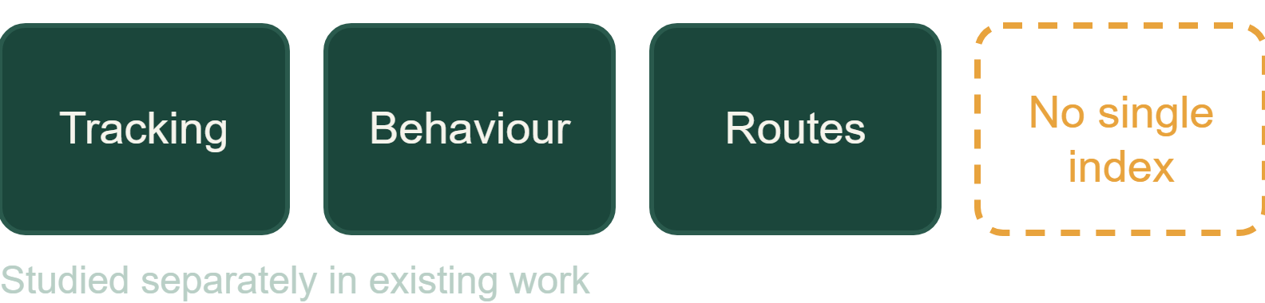

Research gap and objective
The gap
The proposal
Few studies build a composite performance index for micro-mobility efficiency.
GMEI: one 0 to 1 score from Comfort, Stability and Energy Efficiency.
Existing work focuses on vehicle tracking, travel behaviour and route optimisation. Comfort, stability and operational efficiency are rarely assessed within one framework.
Built from accelerometer and gyroscope data captured with the Phyphox app on an e-bike rider at a private university in northern Malaysia.
Suliman & Abeykoon · Green Mobility Efficiency Index
3

Slide 4
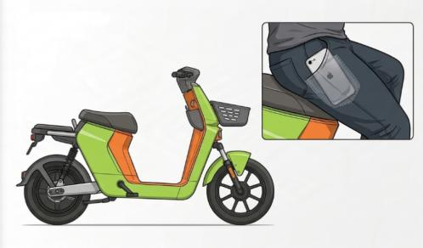
Experimental setup
iPhone SE (2nd Gen) running Phyphox, placed in the rider's trouser pocket
Tri-axial acceleration and angular velocity recorded
Three rides along the full circular campus pathway
Same e-bike model, different riders
Calibration on a stationary surface to check readings and reduce drift and mounting bias
CSV export, processed in Python 3
Fig. 1 Placement of the smartphone in the experimental setup
Suliman & Abeykoon · Green Mobility Efficiency Index
4

Slide 5



Three metrics from the inertial signals
Comfort (C)
Stability (S)
Energy Efficiency (E)
Vertical acceleration
Lateral acceleration and yaw rate
Longitudinal acceleration
RMSz = √(mean(az²))
MAA = mean(|ax|)
SDy = std(ay)
C = 1 / RMSz
E = 1 / MAA
RMSωz = √(mean(ωz²))
S = 1 / (SDy + RMSωz)
Reciprocals mean higher values indicate smoother, more stable and more efficient riding. The metrics follow ISO 2631-1:1997 recommendations and serve as simple empirical proxies.
Suliman & Abeykoon · Green Mobility Efficiency Index
5

Slide 6
Computing the GMEI
1
2
3
4
Load data
→
Derive C, S, E
→
Normalise
→
Average
Read and preprocess Phyphox CSV signals
Compute the three metrics for each trip
Min-max scale each score to [0, 1] across trips
Combine the three normalised scores
GMEI = (Enorm + Cnorm + Snorm) / 3
Values closer to 1 indicate smoother, more stable, energy-efficient e-bike operation.
Suliman & Abeykoon · Green Mobility Efficiency Index
6

Slide 7
Results: scores for each trip
Score | Trip 1 | Trip 2 | Trip 3
Comfort (C) | 0.0921 | 0.0997 | 0.0655
Stability (S) | 0.2353 | 0.6241 | 0.1855
Energy Efficiency (E) | 0.4162 | 0.5111 | 0.4756
GMEI | 0.0539 | 0.0908 | 0.0572
Trip 2 scored highest
Trip 3 was the bumpiest
It led on all three components and on GMEI (0.0908), with the lowest lateral variability (SDy 1.2344) and yaw-rate RMS (0.3680).
Its vertical RMS was the largest (15.28), giving the lowest comfort score (0.0655) and a GMEI of 0.0572.
Source: Table 2 of the manuscript
7

Slide 8
Summary statistics across three trips
GMEI
Comfort
Stability
Energy Efficiency
0.0673
0.0858
0.3483
0.4676
SD 0.0204
SD 0.0180
SD 0.2401
SD 0.0479
95% CI [0.0166, 0.1180]
95% CI [0.0412, 0.1304]
95% CI [–0.248, 0.945]
95% CI [0.3485, 0.5867]
Comfort and energy efficiency varied little between runs; stability varied most.
Source: Table 3 of the manuscript (GMEI range 0.0539 to 0.0908)
8

Slide 9
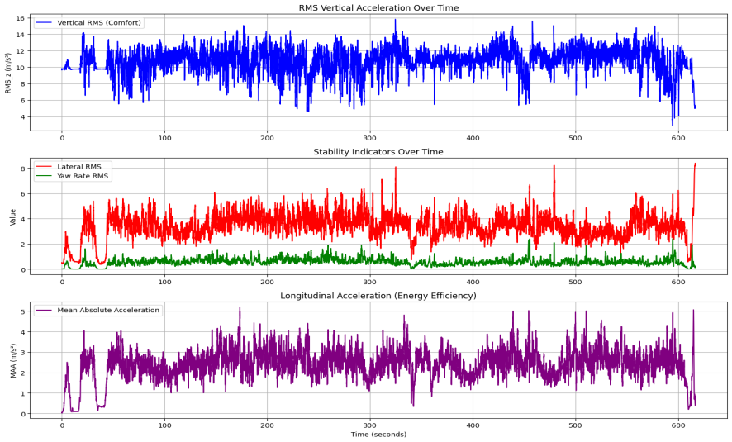
Trip 1 signal traces
Top: vertical RMS
Fluctuating vibration intensity directly shapes the Comfort index.
Middle: lateral and yaw rate
Tracks changes in riding direction and interaction with the environment (Stability).
Bottom: longitudinal acceleration
Changing acceleration patterns are captured by Energy Efficiency.
Fig. 2 Vertical RMS, stability indicators and longitudinal acceleration during trip 1
9

Slide 10
Conclusions and future work
Conclusions
Limitations and next steps
GMEI merges comfort, stability and energy efficiency into one 0 to 1 score
It captured variation in vibration, steering and acceleration along the route
Low-cost smartphone sensing is feasible for campus mobility evaluation
Exploratory: three traversals, one circular route, one e-bike model
Preliminary validation, not statistically generalisable
Next: multiple routes, repeated trials (peak and off-peak, weather, riders) and entropy or PCA weighting
Suliman & Abeykoon · Green Mobility Efficiency Index
10

Slide 11
Thank you
Ride, Sense, Score
Questions and discussion
Khairul Rizuan Suliman and Akila Thenuka Abeykoon
Faculty of Science, Universiti Tunku Abdul Rahman, Kampar, Perak, Malaysia
rizuans@utar.edu.my

